Slide 1
Nodus of Evil
Instruction Manual

Slide 2
Thank you for trying out Nodus of Evil
Game Description
In a land controlled by fearsome gods, the battlefield is set. The cruel god Satrina awaits her opponent. The victor will shape the world in their image.
This world is mine
--SATRINA

Slide 3
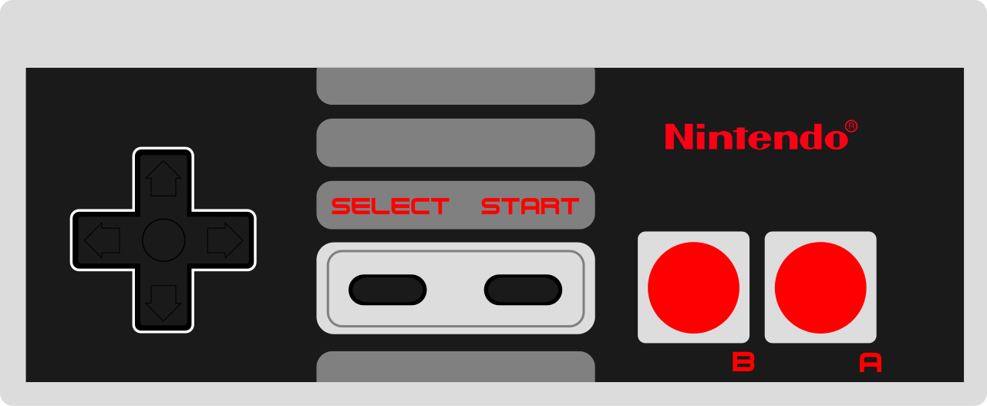
How to Play
Press left or right to move accordingly
Press A to jump

Slide 4
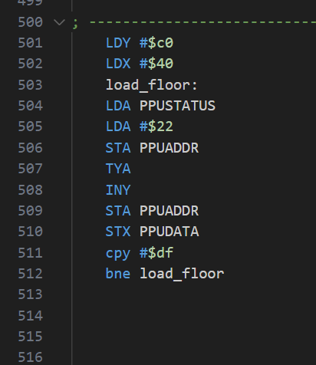
How it was Made: Background
NEXXT was used to create a nametable.
Using the NEXXT canvas, the background was designed
In the actual code, information provided by nexxt was used to load the appropriate values into the ppu.
These values allowed for the display of the background.
A loop designed to load the floor tiles

Slide 5
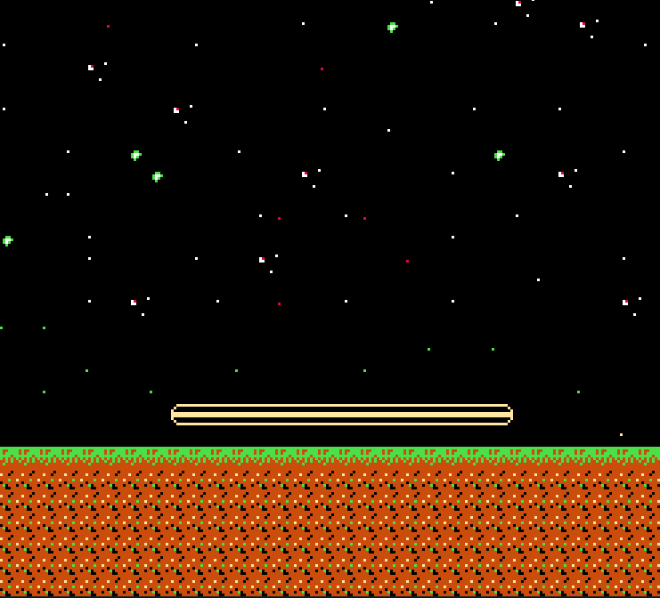
The battlefield is set...

Slide 6
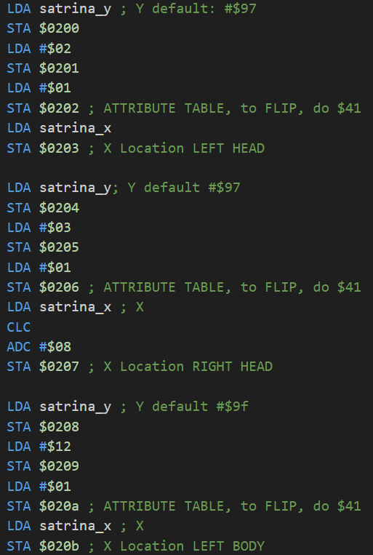
How it was made Character
Pixilart.com was used to design the main character sprite
The character sprite is made up of 6 different tiles.
Recreating the sprite in NEXXT allowed the graphics to be included in the game’s chr file.
Code for loading the first 3 sprites corresponding to satrina

Slide 7
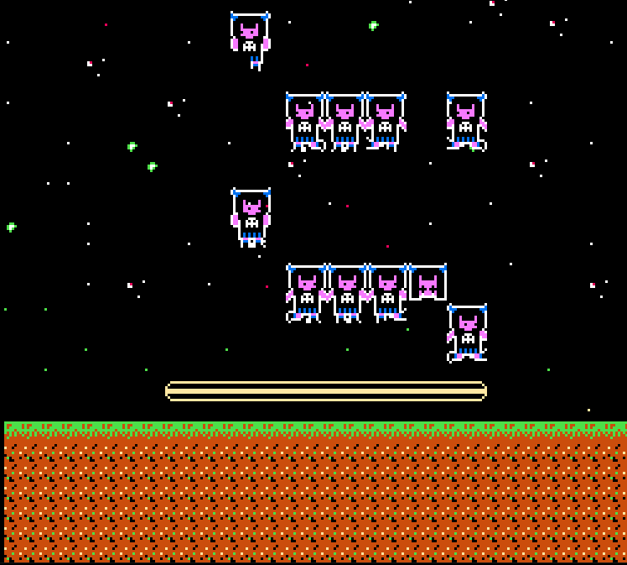
Satrina arrives

Slide 8
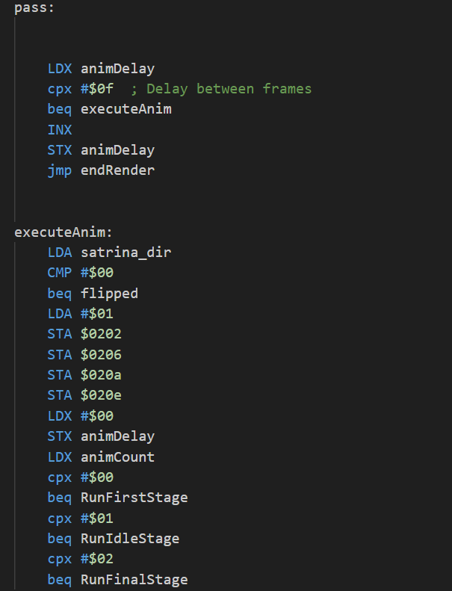
HHow it was made Animation
During the non maskable interrupt, the render and draw procedures are called.
animDelay and animCount were created in the zeropage.
Everytime animdelay reaches 10, animcount increases by 1.
Draw renders the sprite according to animcount.
Code handling the animation

Slide 9
Satrina is warming up...

Slide 10
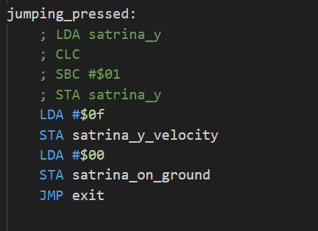
How it was made Movement
Player x and y values were declared in the zeropage.
These values were incremented or decreased according to the current gamepad status.
Vertical movement was calculated by applying a sudden vertical velocity and decreasing it every frame. This resulted in a jumping arc.
Code showing the upwards velocity being set.

Slide 11
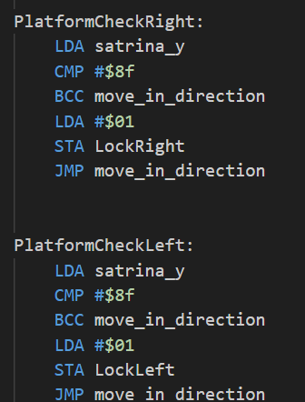
How it was made Collision
Boundaries were defined using X and Y positions./If satrina would approach these, the appropriate direction would become locked.
Boundaries include the left border, the right border, the platform right border, the platform left border.
In order for satrina to land on the platform, if she is within the platform x position range, the ground is shifted upwards.
Code showing the platform collision

Slide 12
Satrina examines the battlefield...

Slide 13
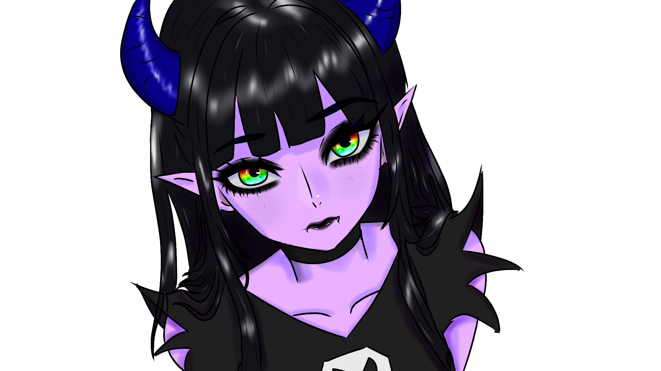
Thank you

Slide 14
Github repository
https://github.com/AcevedoC17/CIIC4082Project1

